Slide 1

Compression to Balloon Time
Who Should Have Cardiac Catheterization after ROSC
Clay Smith, MD, FACEP

Slide 2
Objectives
Review literature on post-resuscitation percutaneous coronary intervention
Develop decision making framework for directing post-resuscitation PCI

Slide 3
Background
CAD/ACS thought to be most common cause of out of hospital non-traumatic cardiac arrest
Initial V-fib or V-tach thought to be associated with higher likelihood of ACS
Traditionally some controversy in how to manage patients post-ROSC

Slide 4
Case #1
65 y/o female, out-of hospital cardiac arrest
  Witnessed with immediate bystander CPR
  5 minutes of total CPR
  ROSC with EMS after defibrillation for v-fib
  BP 110/60

Slide 5
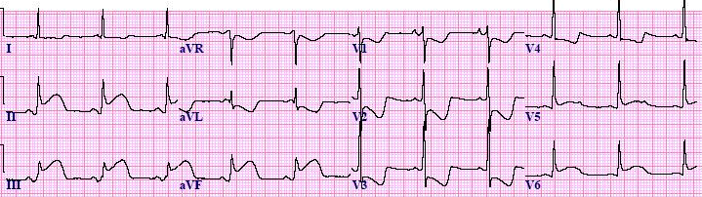
Case #1
https://www.healio.com/cardiology/learn-the-heart/blogs/stemi-mi-ecg-pattern

Slide 6
Case #2
65 yo female, out-of hospital cardiac arrest
  Witnessed with immediate bystander CPR
  5 minutes total CPR
  ROSC with EMS after defibrillation for v-fib
  BP 110/60

Slide 7
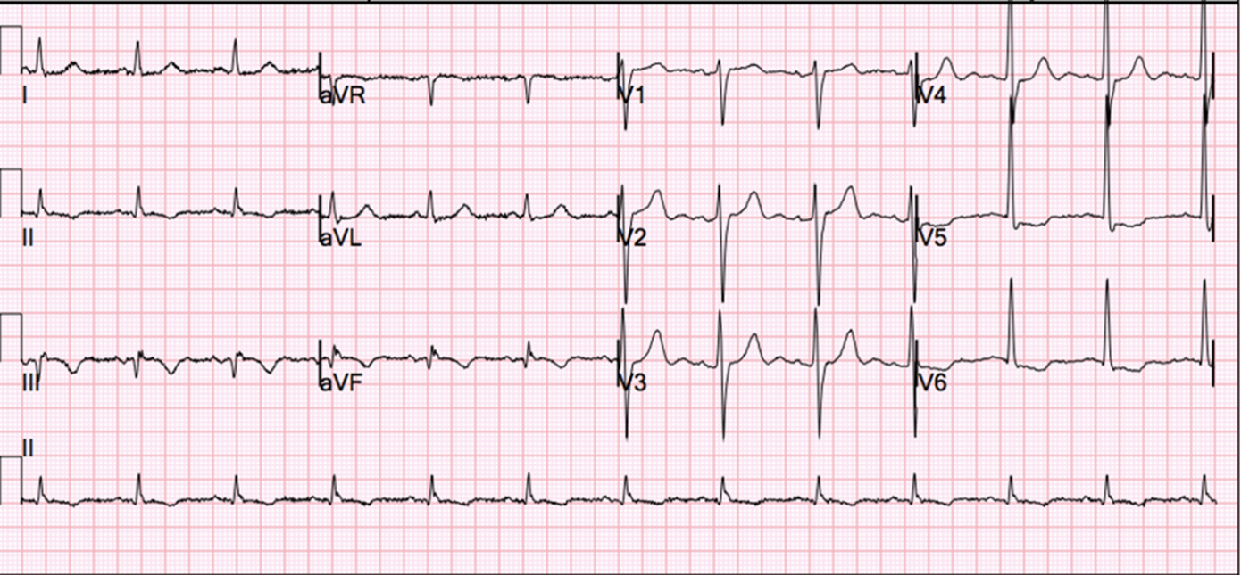
Case #2
https://www.acc.org/education-and-meetings/patient-case-quizzes/a-54yo-man-with-an-nstemi-and-upcoming-non-cardiac-surgery

Slide 8
Case #2
65 yo female, out-of hospital cardiac arrest
  Witnessed with immediate bystander CPR
  5 minutes total CPR
  ROSC with EMS after defibrillation for v-fib
  BP 110/60

Slide 9
Case #3
65 yo female, out-of hospital cardiac arrest
  Witnessed arrest
  No bystander CPR
  15 minutes before EMS arrival
  ROSC with EMS
  Total CPR time 45 minutes
  pH 7.0, Lactate 7.0
  BP 80/40

Slide 10
Case #3
https://www.acc.org/education-and-meetings/patient-case-quizzes/a-54yo-man-with-an-nstemi-and-upcoming-non-cardiac-surgery

Slide 11
PROCAT Registry
Parisian Region Out of Hospital Cardiac Arrest Registry
435 patients with ROSC
  No obvious extracardiac cause (trauma, PE, etc)
96% of STEMIs had significant CAD lesion
58% of patients without STEMI had significant CAD lesion
Successful PCI associated with increased survival

Slide 12
PROCAT II Registry
695 Cardiac Arrests without STEMI
29% required PCI
Shockable rhythm associated with 2x likelihood of coronary lesion requiring PCI
Favorable outcome
  43% in group with PCI-ammenable lesion
  33% in group with no culprit coronary lesion

Slide 13
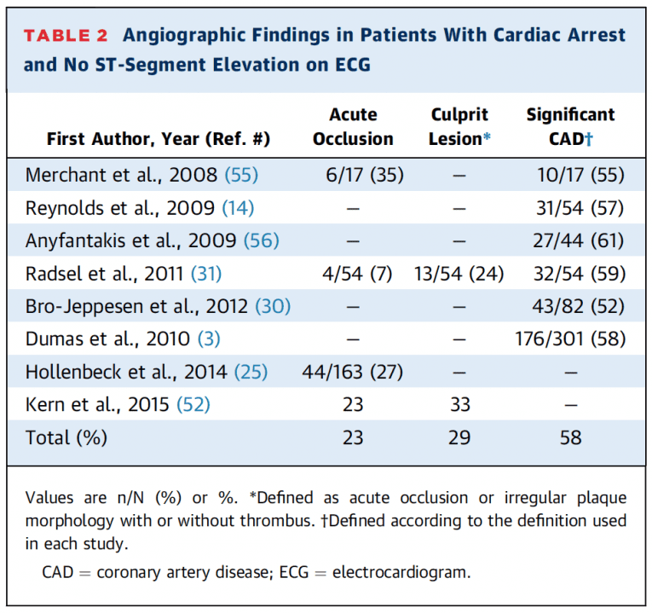
Other Studies

Slide 14
ACC Guidelines (2013)
STEMI
  ACC/AHA Class 1b recommendation for immediate PCI
ECG without STEMI
  No clear guidelines in US

Slide 15
ESC Guidelines - 2017
STEMI
  Immediate PCI
Patients with suspected NSTEMI:
  Exclude non-coronary causes
  Urgent angiography within 2 hours
Take into account factors associated with poor neurological outcome

Slide 16
Rab Et Al – JACC 2015
Cardiac Arrest: A Treatment Algorithm for Emergent Invasive Cardiac Procedures in the Resuscitated Comatose Patient
Divides patients into STEMI or no STEMI

Slide 17
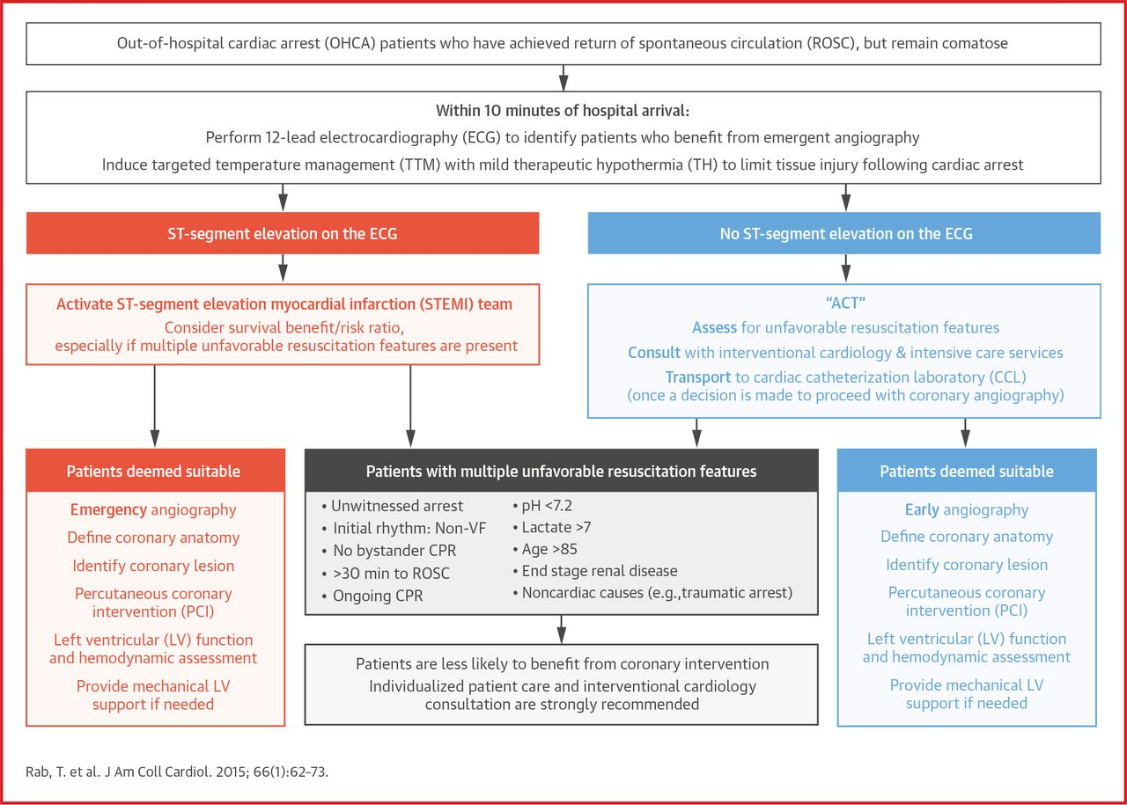

Slide 18
COACT Trial: NEJM 2019
552 VF/VT arrest patients
Randomized to immediate vs delayed cath
<20% found to have unstable plaque
No difference in 90 day survival
No difference in neurologic outcomes measured

Slide 19
COACT Trial: NEJM 2019
Potential limitations
  Non-blinded
  What about patients with history strongly suggestive of ACS?
  Relatively low powered (stated needed 40% difference to detect)

Slide 20
The Bottom Line
STEMIs need emergent PCI after ROSC
No STEMI
  JACC article and European Guidelines recommend PCI
  Evaluate for non-cardiac stuff
  May be moving away from routine cardiac cath
  Watch for more studies

Slide 21
Case #1
STEMI
Quick ROSC, now Stable(ish)
STEMI Alert

Slide 22
Case #2
Not a STEMI
Presenting V-Fib Pattern
Suspected Ischemic ECG
Call cardiologist
Gently encourage urgent cardiac cath

Slide 23
Case #3
Not a STEMI
Prolonged down-time
Acidosis
Poor Prognosis
Do not activate STEMI
Discuss with cardiology, may be reasonable to avoid initial cath

Slide 24
Dumas, F et al. Immediate Percutaneous Coronary Intervention Is Associated With Better Survival After Out-of-Hospital Cardiac Arrest, Circulation: Cardiovascular Interventions, Jun 2010
O'Gara, P et al. 2013 ACCF/AHA Guideline for the Management of ST-Elevation Myocardial Infarction
Lemkes JS et al. Coronary Angiography after Cardiac Arrest Without ST-Segment Elevation. NEJM 2019.
Dumas, F et al. Emergency Percutaneous Coronary Intervention in Post-cardiac Arrest Patients without ST-Segment Elevation Pattern: Insights From the PROCAT II Registry. JACC Cardiovascular Interventions, 2016 May 23.
Rab, T et al. Cardiac Arrest: A Treatment Algorithm for Emergent Invasive Cardiac Procedures in the Resuscitated Comatose Patient. J Am Coll Cardiol. 2015 Jul 7;66(1):62-73.
Ibanez, et al. 2017 ESC Guidelines for the Management of Acute Myocardial Infarction in Patients Presenting With ST-Segment Elevation: The Task Force for the Management of Acute Myocardial Infarction in Patients Presenting With ST-Segment Elevation of the European Society of Cardiology (ESC). Eur Heart J Aug 2017

